Slide 1
ECA - Key challenges for system improvements.
26 September 2023
Homologues Group
30th annual meeting of the European Auditors of Cohesion Funds
Helga Berger, Member of the European Court of Auditors
Valeria Rota, Principal Manager

Slide 2



Audit scope and approach
Main system findings
Key players and areas for improvement
System findings at audit authority level
Closing remarks

Slide 3
Audit scope and approach

Slide 4
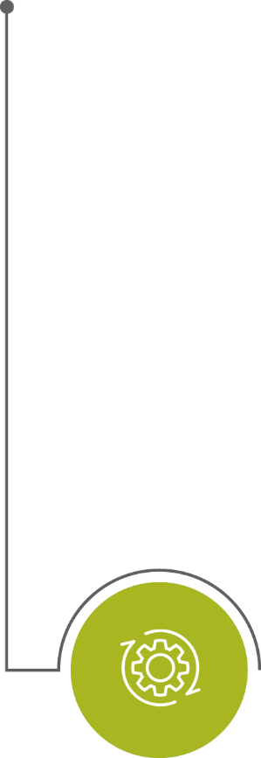


The ECA’s audit approach
STATEMENT OF ASSURANCE
PERFORMANCE
AUDIT
Reliability of the accounts (financial audit)
Examine accounting records and financial statements
Legality and regularity of transactions underlying the accounts (compliance audit)
Examine control systems intended to prevent or detect and correct errors
Test a sample of transactions (revenue and expenditure)
Audit subjects which are likely to yield high impact in terms of identifying potential improvements
Principles of sound financial management: effectiveness, efficiency and economy of EU policies and programmes
ISSAIs: the international standards on auditing issued by INTOSAI
Slide 0

Slide 5
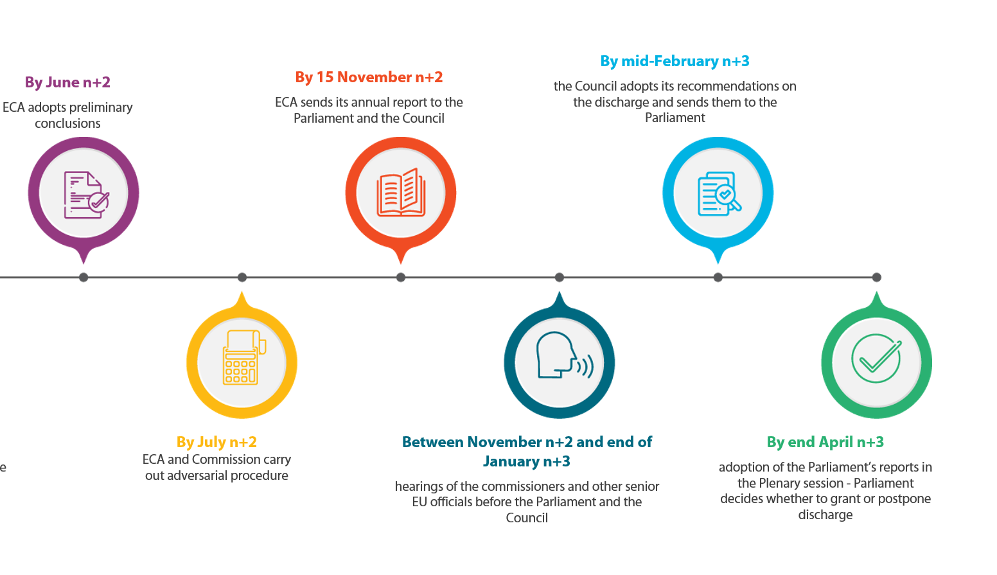

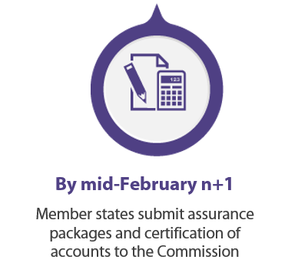

Discharge procedure: annual report
July 2020 (n-1) – June 2021 (n)
Audited accounting year
By June 2022 (n+1)
ECA’s first sample
audit period
Slide 0

Slide 6
Statement of assurance: our audit approach for Cohesion
ISSAI 4000, paragraph 37: “direct reporting engagement”
Auditors evaluate evidence against audit criteria. This means that we used to pick a random, statistically representative sample of operations, and we audited it ourselves.
Until 2016:
We drew our sample from all interim and final payments made from the EU budget to operational programmes during the year.
Since 2017:
We draw our sample from the annual assurance packages for which the Commission has accepted the accounts, i.e. after audit authorities have completed their work and the necessary financial corrections have been made.
The sample includes mainly transactions already audited by audit authorities.
Slide 0

Slide 7
Statement of assurance: our audit approach for Cohesion
Slide 0

Slide 8
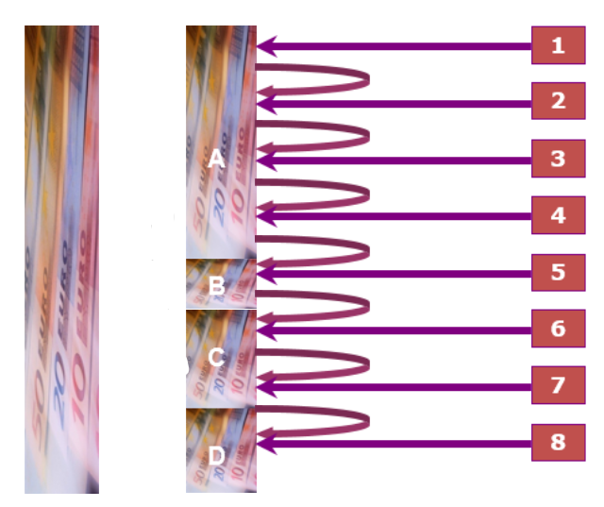
Sampling approach for Cohesion
Monetary unit sampling (MUS)
a method of statistical sampling in which every euro has an equal chance of selection
Several stages of sampling
1) we sample the assurance package
2) we sample operations from the sample audited by the audit authority
3) we audit subsamples of 30 expenditure items in cases where the audit authority audited more
The results of our audit of these statistical samples can be extrapolated to the whole population
Slide 0

Slide 9
Statement of assurance:
Work done since 2017 for Cohesion
Background information
Member states submitted 1620 assurance packages in total (2017-2022)
On average, we covered 23 assurance packages per year
As we use MUS, our sample covered around 50% of expenditure certified in the accounts
PRESIDNCY
SECRETAIAT
GENERAL
AUDIT QUALITY CONTROL COMMITTEE
Slide 0

Slide 10
Main system findings
Key players and areas for improvement
System findings at audit authority level

Slide 11
Key players and areas for improvement

Slide 12
Key player: national authorities
First line of defence in the national control system
Main areas for improvement:
  project selection
  management verifications
to avoid ineligible expenditure being declared to the Commission
Second line of defence
We report errors not detected or not correctly quantified by audit authorities
Areas for improvement
  the planning and preparation of audit work
  in the audit work itself
  and finally in the documentation of audit work

Slide 13
Assessment of the work of audit authorities
PRESIDNCY
SECRETAIAT
GENERAL
2022
AUDIT QUALITY CONTROL COMMITTEE

Slide 14
Key player: European Commission
The Commission is the third line of defence
The framework in place still contains rooms for improvements
inherent limitations of the desk reviews – risk that irregularities remain undetected
Commission detect many error in its compliance audits – confirmation of shortcomings in AA checks and of limitation of its own desk reviews
Compliance audits have limited coverage of both OPs and operations
Room for improvement in the audit work and audit documentation
Lengthy follow-up procedures after Commission’s compliance audits
We recommended that the Commission improve its risk assessment, audit documentation and review process

Slide 15
System findings at audit authority level
Planning and preparation of audit work
Audit work and reporting
Documentation of audit work

Slide 16
Weaknesses in planning and preparation of audits
Weaknesses in the sampling approach
Weaknesses in checklists
The findings we address to audit authorities are not properly followed up

Slide 17
Weaknesses in audit authorities’ checklists
Improvements observed, but weaknesses persist in the following areas:
state aid: checklists do not sufficiently address certain aspects of specific notified state aid schemes
conflict of interest: checklists do not cover conflict of interest between the authority granting the aid and the beneficiary
fraud risk assessment: checklists do not cover fraud risk sufficiently
eligibility: checklists do not address e.g. proper application of selection criteria, eligibility of expenditure or the risk of double funding

Slide 18
System findings at audit authority level
Planning and preparation of audit work
Audit work and reporting
Documentation of audit work

Slide 19
Weaknesses in audit work and reporting
Weaknesses resulting in undetected errors
    no audits or only partial audits of selection and eligibility criteria
    no audits of self-declarations
Incorrect treatment of detected errors
    incorrect quantification of errors
    AA issue reports without finalising their audit work and do not place affected amounts under ongoing assessment

Slide 20
    No audits or only partial audits of selection and eligibility criteria
project selection: audit authority did not check all eligibility criteria given in the call – beneficiary did not comply with the criteria and should not have been selected
eligibility of expenditure: audit authority did not detect that expenditure had not been paid in full by the beneficiary
procurement rules: audit authority did not properly check the compliance of new subcontractors with the eligibility criteria
conflict of interest: the audit authority failed to identify a conflict of interest in a specific public procurement procedure

Slide 21
Example: Ineligible expenditure for COVID-19 emergency support
Project objective: mitigate the impact of the COVID-19 pandemic by providing financial support to employers and self-employed workers
Requirement: turnover reduced by at least 20%
Finding: The beneficiary reported incomplete sales income. The fall in turnover was below the minimum required, making the beneficiary ineligible for support. The audit authority did not detect this when assessing the managing authority’s decision on eligibility.

Slide 22
Beneficiaries’ self-declarations not checked against reliable and verified sources
Self-declarations are used to verify eligibility criteria and other requirements
Audit authorities had not requested and verified further supporting evidence
No checks on
  de minimis
  conflict of interest
  double funding
  SME criteria
  NEET criteria

Slide 23
Incorrect treatment of errors
Incorrect treatment of errors / corrections
  In some cases, even when audit authorities identified an irregularity, they did not raise a quantifiable finding, did not correctly calculate the error, or did not recommend the necessary financial corrections in line with the Commission Decision.
AA issued reports before finalising its audit work and affected amounts were not placed under ongoing assessment
  An audit authority issued its audit report although additional evidence was still pending. The audit result cannot be considered final.

Slide 24
System findings at audit authority level
Planning and preparation of audit work
Audit work and reporting
Documentation of audit work

Slide 25
Reperformance of audited transactions
73%
56%
29%
56%
51%
37%
51%
51%
51%
22%
45%
37%
45%
29%
25%
20%
28%
22%
20%
20%
20%
25%

Slide 26
Weaknesses in audit documentation
Reasons for reperformance
No information about which underlying documents were checked and against which criteria
Missing or incorrect replies in checklists
Missing or incorrect references to other working papers
Replies without explanation (yes/no answers, more detail needed)
Areas where reperformance was needed
  SCO methods
  double funding
  90-day payment deadlines
  on-the-spot verification

Slide 27
Closing remarks

Slide 28
Closing remarks
Room for improvement in the scope and documentation of audit work
Weaknesses in the work of several audit authorities still limit the reliance that can be placed on their work
  ECA reperformance of checks at the level of managing authority / intermediate bodies or beneficiaries
Quantifiable errors found that were not previously identified by audit authorities

Slide 29
Closing remarks
Audit authorities need to pay special attention to:
keeping an audit trail of the sampling process
the coverage of checklists (especially in regard to state aid, fraud risk assessment, etc.)
including detailed instructions in checklists (e.g. ‘’if the answer to the question is yes, please explain your conclusion and describe your audit work’’)
documenting checks and making clear reference to the most relevant documents to show which criteria were verified and how they were documented
following up our findings appropriately and at the proper time

Slide 30
Closing remarks
Audit authorities need further to:
improve audit procedures designed to address recurring errors, specifically in relation to ineligible costs and projects
  improve the checks confirming the reliability of self-declarations
pay special attention to:
  the correct application of state aid rules
  the correct application of guidance on financial corrections
  finalising their audits before issuing audit reports

Slide 31
Closing remarks
Audit authorities may give managing authorities relevant feedback
For example, exchange or publish:
  checklists for systems audits and audits of operations
  an annual analysis of the errors they detect, focusing on:
    ineligible expenditure
    ineligible projects
    infringements of public procurement and state aid rules, etc.

Slide 32

Contact details
Helga Berger
Österreichisches Mitglied am ERH
helga.berger@eca.europa.eu
linkedin.com/in/helga-berger-056746200
Valeria Rota
Principal Manager
valeria.rota@eca.europa.eu
Want to know more about our work?
Visit our website: eca.europa.eu
Follow us on Twitter: @EUAuditors
Check our pages on LinkedIn and Facebook
Contact us at ECA-info@eca.europa.eu

